Slide 1
Chapter 10
Arrays and Collections

Slide 2
Objectives
After you have read and studied this chapter, you should be able to
Manipulate a collection of data values, using an array.
Declare and use an array of primitive data types in writing a program.
Declare and use an array of objects in writing a program
Define a method that accepts an array as its parameter and a method that returns an array
Describe how a two-dimensional array is implemented as an array of arrays
Manipulate a collection of objects, using lists and maps
Notes:
We will cover the basic array processing in this lesson, manipulating arrays of primitive data types and objects.

Slide 3
Array Basics
An array is a collection of data values.
If your program needs to deal with 100 integers, 500 objects, 365 real numbers, etc., you will use an array.
In Java, an array is an indexed collection of data values of the same type.

Slide 4
Arrays of Primitive Data Types
Array Declaration
<data type> [ ] <variable> //variation 1
<data type> <variable>[ ] //variation 2
Array Creation
<variable> = new <data type> [ <size> ]
Example
Variation 1
Variation 2
double[ ] rainfall;
rainfall
= new double[12];
double rainfall[ ];
rainfall
= new double[12];
An array is like an object!

Slide 5
Accessing Individual Elements
Individual elements in an array accessed with the indexed expression.
double[] rainfall = new double[12];
rainfall
0
1
2
3
4
5
6
7
8
9
10
11
This indexed expression refers to the element at position #2
The index of the first
position in an array is 0.
rainfall[2]

Slide 6
Array Initialization
Like other data types, it is possible to declare and initialize an array at the same time.
int[] number = { 2, 4, 6, 8 };
double[] samplingData = { 2.443, 8.99, 12.3, 45.009, 18.2,
9.00, 3.123, 22.084, 18.08 };
String[] monthName = { "January", "February", "March",
"April", "May", "June", "July",
"August", "September", "October",
"November", "December" };
number.length samplingData.length monthName.length
4
9
12
Notes:
When an array is initialized in this manner, its capacity is set to the number of elements in the list.

Slide 7
Variable-size Declaration
In Java, we are not limited to fixed-size array declaration.
The following code prompts the user for the size of an array and declares an array of designated size:
Scanner scanner = new Scanner(System.in);
int size;
int[] number;
System.out.print("Size of an array:"));
size= scanner.nextInt( );
number = new int[size];

Slide 8
Array Processing – Sample1
import java.util.Scanner;
public class Rainfall {
public static void main(String args[]) {
double[] rainfall = new double[12];
double sum = 0.0;
double average = 0.0;
Scanner scanner = new Scanner(System.in);
for (int i = 0; i < 12; i++) {
System.out.println(“Rainfall for Month " + (i + 1));
rainfall[i] = scanner.nextDouble();
sum += rainfall[i];
}
average = sum / rainfall.length;
System.out.println("Average Rainfall = " + average);
}
}

Slide 9
Array Processing – Sample 2
import java.util.Scanner;
public class RainfallMonth
{
public static void main(String args[])
{
double[] rainfall = new double[12];
String[] monthName = {"January", "February", "March",
"April", "May", "June", "July",
"August", "September", "October",
"November", "December" };
double sum = 0.0; double average = 0.0;
Scanner scanner = new Scanner(System.in);
// compute average rainfall
for (int i = 0; i < 12; i++)
{
System.out.print("Rainfall for Month " + monthname[i] + " :");
rainfall[i] = scanner.nextDouble();
sum += rainfall[i];
}
average = sum / rainfall.length;
System.out.println("Average Rainfall = " + average);
}
}

Slide 10
Compute quarterAverage rainfall
double quarterAverage[] = new double[4];
int sumq; double avgq;
for (int i = 0; i < 4; i++)
{
sumq = 0;
for (int j = 0; j < 3; j++){
sumq += rainfall[i * 3 + j];
}
avgq = sumq / 3;
quarterAverage[i] = avgq;
}
for (int i = 0; i < quarterAverage.length; i++)
System.out.println("Each quarter Average Rainfall= " + quarterAverage[i]);

Slide 11
Arrays of Objects
In Java, in addition to arrays of primitive data types, we can declare arrays of objects
An array of primitive data is a powerful tool, but an array of objects is even more powerful.
The use of an array of objects allows us to model the application more cleanly and logically.

Slide 12
The Person Class
public class Person {
private int age;
private String name;
private char gender;
public int getAge() {
return age;
}
public void setAge(int age) {
this.age = age;
}
public String getName() {
return name;
}
public void setName(String name) {
this.name = name;
}
public char getGender() {
return gender;
}
public void setGender(char gender) {
this.gender = gender;
}
}

Slide 13
Creating an Object Array - 1
Code
A
Person[ ] person;
person = new Person[20];
person[0] = new Person( );
Only the name person is declared, no array is allocated yet.
person
State
of
Memory
After is executed
A

Slide 14
Creating an Object Array - 2
Code
Person[ ] person;
person = new Person[20];
person[0] = new Person( );
Now the array for storing 20 Person objects is created, but the Person objects themselves are not yet created.
B
person
person
0
1
2
3
4
16
17
18
19
State
of
Memory
After is executed
B

Slide 15
Creating an Object Array - 3
Code
Person[ ] person;
person = new Person[20];
person[0] = new Person( );
One Person object is created and the reference to this object is placed in position 0.
C
person
person
0
0
1
1
2
2
3
3
4
4
16
16
17
17
18
18
19
19
State
of
Memory
Person
After is executed
C

Slide 16
Create Person objects and set up the person array
public class PersonArray {
public static void main(String[] args) {
Person person[] = new Person[3];
Scanner scanner = new Scanner(System.in);
String name; int age; char gender; String str;
for (int i = 0; i < person.length; i++) {
System.out.print("Enter name : "); name = scanner.next();
System.out.print("Enter age : "); age = scanner.nextInt();
System.out.print("Enger gender"); str = scanner.next();
gender = str.charAt(0);
person[i] = new Person(); // create a new Person and assign values
person[i].setName(name);
person[i].setAge(age);
person[i].setGender(gender);
}
}
}

Slide 17
Find youngest and oldest age person
Person youngest = person[0];
Person oldest = person[0];
for (int i = 0; i < person.length; i++) {
if (person[i].getAge() < youngest.getAge()) {
youngest = person[i];
} else if (person[i].getAge() > oldest.getAge()) {
oldest = person[i];
}
}
System.out.println(" Youngest Person Name = " + youngest.getName() + " Age : " + youngest.getAge());
System.out.println(" Oldest Person Name = " + oldest.getName() + " Age : " + oldest.getAge());

Slide 18
Searching for a particular person
int i = 0;
System.out.println("Enter search Name ");
String searchName = scanner.next();
while (i < person.length && !person[i].getName().equals(searchName))
{
i++;
}
if (i == person.length) {
System.out.println(searchName + " was not in the person array");
}
else {
System.out.println(searchName + " was fount at the " + i + " of preson array");
}

Slide 19
Find out the names whose age is >5
int givenAge = 5;
for (int j = 0; j < person.length; j++) {
if (person[j].getAge() > 5) {
System.out.println(" Name : " + person[j].getName() +
" Age : " + person[j].getAge());
}
}

Slide 20
Object Deletion – Approach 1
int delIdx = 1;
person[delIdx] = null;
Delete Person B by setting the reference in position 1 to null.
A
person
person
0
1
2
3
0
1
2
3
A
B
C
D
A
C
D
Before is executed
After is executed
A
A

Slide 21
Object Deletion – Approach 2
int delIdx = 1, last = 3;
person[delIndex] = person[last];
person[last] = null;
Delete Person B by setting the reference in position 1 to the last person.
A
person
person
0
1
2
3
0
1
2
3
A
B
C
D
A
D
C
Before is executed
After is executed
A
A

Slide 22
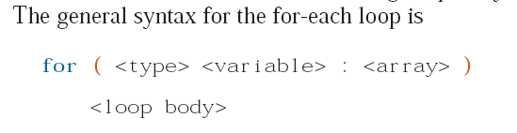
The For-Each Loop
This new for loop is available from Java 5.0
The for-each loop simplifies the processing of elements in a collection
Here we show examples of processing elements in an array
int sum = 0;
int number[] = { 1, 2, 3, 4, 5, 6, 7};
for (int i = 0; i < number.length; i++) {
sum = sum + number[i];
}
int sum = 0;
int number[] = { 1, 2, 3, 4, 5, 6, 7};
for (int value : number) {
sum = sum + value;
}
standard for loop
for-each loop

Slide 23
Processing an Array of Objects with For-Each
Person[] person = new Person[100];
//create person[0] to person[99]
for (int i = 0; i < person.length; i++) {
System.out.println(person[i].getName());
}
standard for loop
for (Person p : person) {
System.out.println(p.getName());
}
for-each loop

Slide 24
For-Each: Key Points to Remember
A for-each loop supports read access only. The elements cannot be changed.
A single for-each loop allows access to a single array only, i.e., you cannot access multiple arrays with a single for-each loop.
A for-each loop iterates over every element of a collection from the first to the last element. You cannot skip elements or iterate backward.

Slide 25
Passing Arrays to Methods
public class SearchMinimum {
static int searchMin(int[] numarray) {
int min = numarray[0];
for (int i = 1; i < numarray.length; i++) {
if (numarray[i] < min)
min = numarray[i];
}
return min;
}
public static void main(String[] args) {
int num[] = { 4, 5, 6, 7, 1, 2 };
int result = searchMin(num);
System.out.println("Minimum number : " + result);
}
}

Slide 26
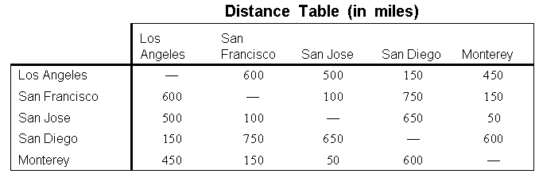
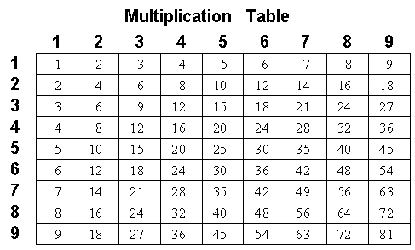
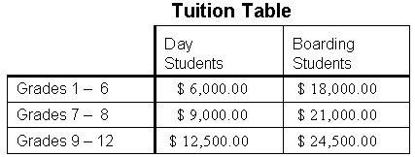
Two-Dimensional Arrays
Two-dimensional arrays are useful in representing tabular information.

Slide 27
Declaring and Creating a 2-D Array
Declaration
<data type> [][] <variable> //variation 1
<data type> <variable>[][] //variation 2
Creation
<variable> = new <data type>[ <size1> ][ <size2> ]
Example
payScaleTable
0
1
2
3
4
0
double[][] payScaleTable;
payScaleTable
= new double[4][5];
1
2
3

Slide 28
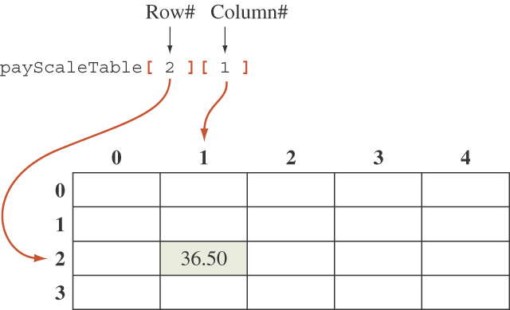
Accessing an Element
An element in a two-dimensional array is accessed by its row and column index.

Slide 29
Two-dimensional Array Illustration
matrix.length? 5
matrix[0].length? 5
array.length? 4
array[0].length? 3

Slide 30
Declaring, Creating, and Initializing Using Shorthand Notations
You can also use an array initializer to declare, create and initialize a two-dimensional array. For example,
int[][] array = {
{1, 2, 3},
{4, 5, 6},
{7, 8, 9},
{10, 11, 12}
};
int[][] array = new int[4][3];
array[0][0] = 1; array[0][1] = 2; array[0][2] = 3;
array[1][0] = 4; array[1][1] = 5; array[1][2] = 6;
array[2][0] = 7; array[2][1] = 8; array[2][2] = 9;
array[3][0] = 10; array[3][1] = 11; array[3][2] = 12;
Same as

Slide 31
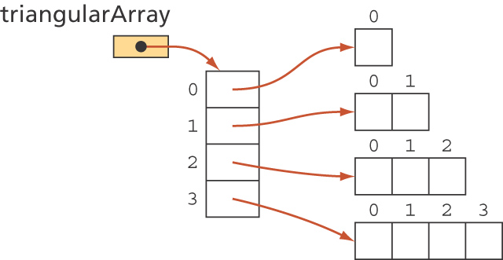
Ragged Arrays
Subarrays may be different lengths.
Such an array is known as a ragged array.
Executing
triangularArray = new double[4][ ];
for (int i = 0; i < 4; i++)
triangularArray[i] = new double [i + 1];
results in an array that looks like:
Notes:
An array that is part of another array is called a subarray.
An array of arrays may be initialized when it is created.

Slide 32
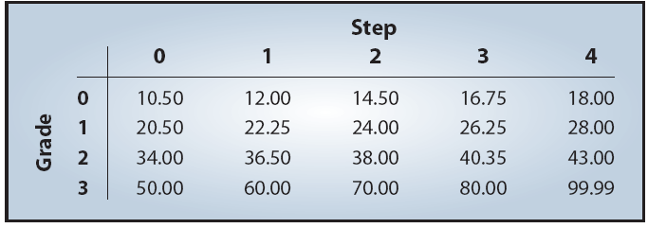
Sample 2-D Array Processing
The table contains the hourly rate of programmers based on their skill
level. The rows (horizontal) represent the grade levels, and the columns (vertical) represent the steps within a grade level. Reading the table, we know a programmer with skill grade level 2, step 1 earns $36.50 per hour.
Find the average of each grade level.

Slide 33
public class PayScaleTable {
public static void main(String[] args) {
double payScale[][] = { { 10.50, 12.0, 14.50, 16.75, 18.00 },
{ 20.50, 22.25, 24.00, 26.25, 28.00 },
{ 34.00, 36.50, 38.00, 40.35, 43.00 },
{ 50.00, 60.00, 70.00, 80.00, 99.99 } };
double average[] = new double[4];
for (int i = 0; i < payScale.length; i++) {
for (int j = 0; j < payScale[i].length; j++) {
average[i] += payScale[i][j];
}
average[i] = average[i] / payScale[i].length;
}
for (int i = 0; i < average.length; i++) {
System.out.println(" Average of Grade Level "+ i + " Employees: "+ average[i]);
}}
}

Slide 34
Collection Classes: Lists and Maps
The java.util standard package contains different types of classes for maintaining a collection of objects.
These classes are collectively referred to as the Java Collection Framework (JCF).
JCF includes classes that maintain collections of objects as sets, lists, or maps.

Slide 35
Java Interface
A Java interface defines only the behavior of objects
It includes only public methods with no method bodies.
It does not include any data members except public constants
No instances of a Java interface can be created

Slide 36
JCF Lists
JCF includes the List interface that supports methods to maintain a collection of objects as a linear list
L = (l₀, l₁, l₂, . . . , l_{N})
We can add to, remove from, and retrieve objects in a given list.
A list does not have a set limit to the number of objects we can add to it.

Slide 37
List Methods
Here are five of the 25 list methods:
boolean add ( E o )
Adds an object o to the list
void clear ( )
Clears this list, i.e., make the list empty
E get ( int idx )
Returns the element at position idx
boolean remove ( int idx )
Removes the element at position idx
int size ( )
Returns the number of elements in the list
E is a generic
class.
Replace E with
a concrete class.

Slide 38
Using Lists
To use a list in a program, we must create an instance of a class that implements the List interface.
Two classes that implement the List interface:
ArrayList
LinkedList
The ArrayList class uses an array to manage data.
The LinkedList class uses a technique called linked-node representation.

Slide 39
Homogeneous vs. Heterogeneous Collections
Heterogeneous collections can include any types of objects (Person, Integer, Dog, etc.)
Homogenous collections can include objects from a designated class only.
For example, to declare and create a list (ArrayList) of Person objects, we write
List<Person> friends;
…
friends = new ArrayList<Person>( ) ;

Slide 40
Sample List Usage
import java.util.ArrayList;
import java.util.List;
public class collection_eg1 {
public static void main(String[] args) {
List<String> fruits= new ArrayList<String>();
fruits.add("apple");
fruits.add("orange");
fruits.add("banana");
for (String f : fruits)
System.out.println(f);
ArrayList<Integer> num = new ArrayList<Integer>();
num.add(1);
num.add(2);
num.add(3);
for (Integer i : num)
System.out.println(i);
}
}

Slide 41
Here's an example of manipulating a list of Person objects:
import java.util.ArrayList;
import java.util.List;
public class ArrayListPerson {
public static void main(String[] args) {
List<Person> personList = new ArrayList<Person>();
Person person;
person = new Person("Su Su", 12, 'F');
personList.add(person);
person = new Person("Aung Aung ", 13, 'M');
personList.add(person);
for (Person p : personList)
System.out.println("Name : " + p.getName() + " Age : " + p.getAge() + " Gender : " + p.getGender());
}
}

Slide 42
JCF Maps
JCF includes the Map interface that supports methods to maintain a collection of objects (key, value) pairs called map entries.
key
value
k₀
v₀
one entry
k₁
v₁
.
.
.
.
.
.
k_{n}
v_{n}

Slide 43
Map Methods
Here are five of the 14 list methods:
void clear ( )
Clears this list, i.e., make the map empty
boolean containsKey ( Object key )
Returns true if the map contains an entry with a given key
Object put (Object key, Object value)
Adds the given (key, value) entry to the map
boolean remove ( Object key )
Removes the entry with the given key from the map
int size ( )
Returns the number of elements in the map
Notes:
There are total of 14 methods defined in the List interface. The five listed here are the very frequently used subset of these 14 methods.

Slide 44
Using Maps
To use a map in a program, we must create an instance of a class that implements the Map interface.
Two classes that implement the Map interface:
1) HashMap
HashMap is the implementation of Map, but it doesn't maintain any order.
2) TreeMap
TreeMap is the implementation of Map and SortedMap. It maintains ascending order.

Slide 45
Sample Map Usage
Here's an example of manipulating a map:
import java.util.*;
public class Map_eg {
public static void main(String[] args) {
Map<String,String> catalog;
catalog = new TreeMap<String,String>();
catalog.put("CS101", "Intro Java Programming");
catalog.put("CS301", "Database Design");
catalog.put("CS413", "Software Design for Mobile Devices");
if (catalog.containsKey("CS101")) {
System.out.println("We teach Java this semester");
} else {
System.out.println("No Java courses this semester");
}
for (Map.Entry<String,String> entry : catalog.entrySet()) {
System.out.println(entry.getKey() + ":\t" + entry.getValue());
}
}
}
Notes:
Two useful methods defined in the Map.Entry interface are the getKey and getValue, whose purpose is to retrieve the key and the value of an entry, respectively

Slide 46
Exercises: No. 11, 12, 13

